Slide 1

Dmitrii Koshkidko, Amir Bukhari,
Justin Spreitzer, Khypee Mangrobang

Slide 2
Vmad
Very masterful, always dedicated
As a company we provide the best in web design and other media projects for clients
Have created many websites in the past for clients
Roles at Vmad
Everyone will contribute equally and help in areas that need work throughout the project

Slide 3

Dmitrii
Backend database for the company
Has a knack for design

Slide 4

Khypee
Back end database
Has been working with computers his whole life

Slide 5

Amir
Front end designer of website
Very good at coding

Slide 6

Justin
Team leader for prototype 1
Front end designer of the site

Slide 7
Show Excel Schedule File
We created our work breakdown structure schedule for prototype 1 and will continue using it for prototype 2 and 3

Slide 8
Main users
User
Anyone on the internet will be able to view site and find information on the Hamilton Program for Schizophrenia
Client
Needs information on schizophrenia in a more user friendly interface
Ability to log in to view events and input Fitbit data to website for tracking
Workers/Administrator
Needs to be able to view events and update website
Board Members
Needs to see budget and track budget using budget tracker

Slide 9
Show Use Cases Word File

Slide 10




Main Metaphor
Principal (Board members)
Students (Clients)
Teachers (Administrator(s))
Students go to input work as a client would input their steps, teachers mark the work as an administrator would view steps

Slide 11
Students (Clients)
Upload walking data like a student would submit work for the teacher
A student can sign up for many events when he or she arrives at school, the same could be said for the client.. When they enter the log in to the website they will be able to sign up for events
Students go to school to learn, the client will be logged into the website to learn about schizophrenia

Slide 12
Principal (Board Member)
A board member will be able to log in to the website and view the budget tracker just like a principal of a school would budget the money out for the entire school year
The principal is in charge of the school just as the board members are in charge of the organization

Slide 13
Teacher (Administrator(s))
The teacher is the one who organizes, updates information, plans events and schedules a day at school
The administrator will have ease of editing the site to make future changes: change pictures, upload files, add calendar events, etc. just as a teacher would be in charge of their classroom

Slide 14
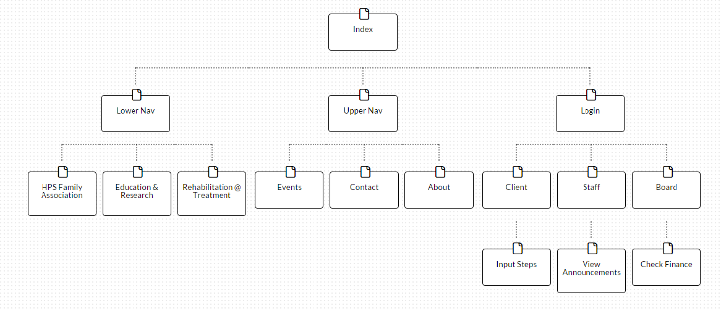
Site Map

Slide 15
Questions for Client
Is there any additional information required for the board of directors other than meeting schedule and announcements?
Would you like to have the access to creating accounts or leave it up to the client?
Will every client that comes into the service be given an account to log into the website?

